Slide 1
8BIO Test Revision

Slide 2
Musculoskeletal System: Bones

Slide 3
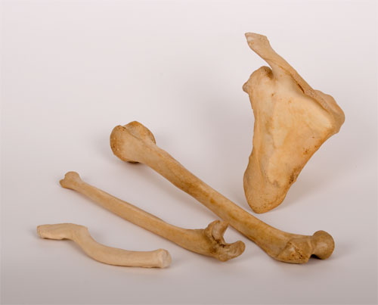
Characteristics of Bones
Bones need to be strong so they don’t snap under normal activity.
They must be light so they can be moved by muscles.
They must be elastic so they can be compressed and stretched without breaking.

Slide 4
Structure of Bones
There are two types of bone tissue:
Compact bone is dense and heavy. This gives bone its strength.
Spongy bone is porous and looks like honeycomb. The spaces in the bone make it light.

Slide 5
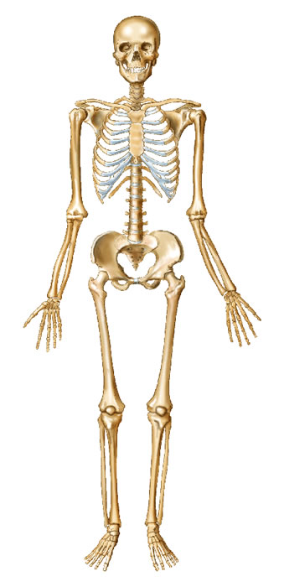
Skull
Clavicle
Ribs
Humerus
Vertebrae
Radius
Pelvis
Ulna
Femur
Patella
Tibia
Fibula

Slide 6
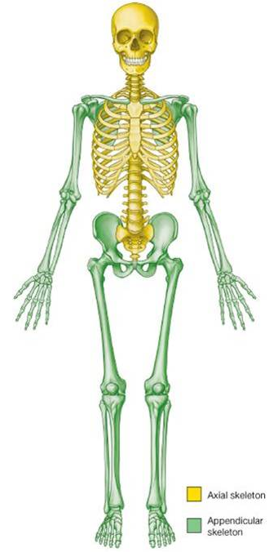
The axial skeleton – bones that protect vital organs.
The appendicular skeleton – bones that allow movement.

Slide 7
Musculoskeletal System: Muscles and Joints

Slide 8
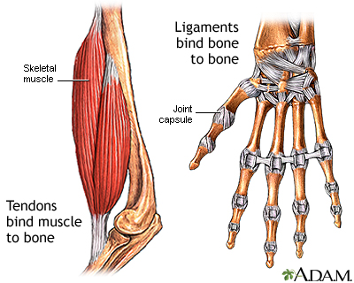
Tendons and Ligaments
Tendons and ligaments are tough bands of tissue.
Tendons connect muscles to bones.
Ligaments hold bones together.

Slide 9
Muscles
Muscles are able to contract.
They pull on the bone they are attached to, via a tendon, causing the bone to move.
Muscles can only pull, they cannot push.
Another muscle is needed to move the bone back to its original position.

Slide 10
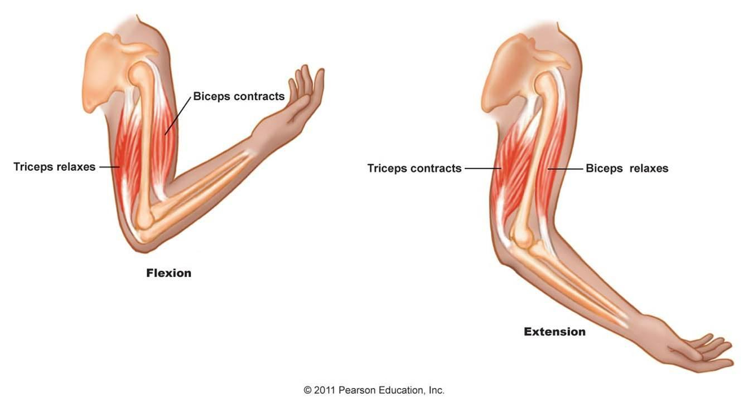
Antagonistic Muscles
Muscles are arranged in antagonistic pairs that work in opposition to each other.
The biceps and triceps are an antagonistic pair.
The biceps contracts, raising the forearm.
The triceps contracts, lowering the forearm.

Slide 11
Types of Muscles
Skeletal muscles are voluntary, and move the bones of the skeleton.
Smooth muscles are involuntary, and help our internal organs carry out functions such as breathing and digestion.
Cardiac muscles (heart muscles) allow the heart to beat continuously.

Slide 12
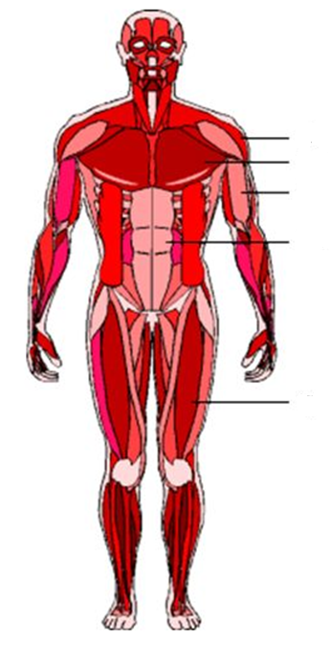
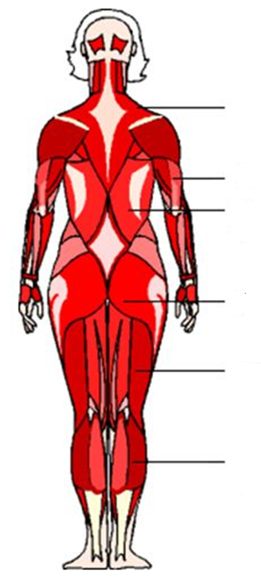
Deltoids
Trapezius
Pectorals
Triceps
Biceps
Latissimus dorsi
Abdominals
Gluteals
Quadriceps
Hamstrings
Gastrocnemius

Slide 13
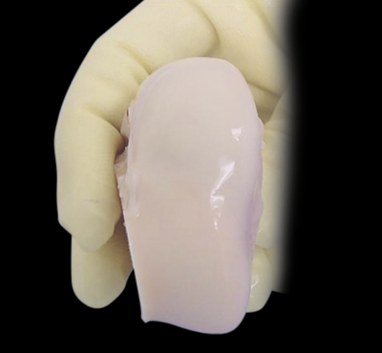
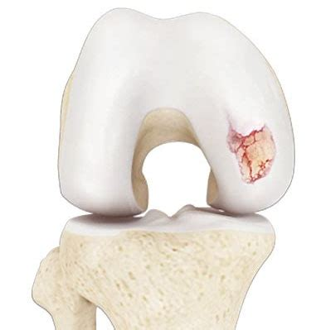
Joints
Joints are where two bones meet.
The ends of bones are covered in a smooth, slippery material called cartilage.
Cartilage reduces friction between the bones when they move.

Slide 14
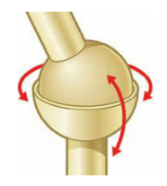
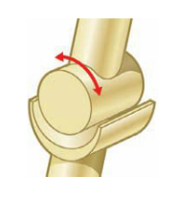
Types of Joints
Hinge
Ball and Socket
Only moves backwards and forwards (like a door hinge)
Examples are the elbow, knee and finger joints
Allows movement in all directions
One bone has a ball shaped end that fits into the cup shape of the other bone
Examples are the hip and shoulder

Slide 15
Circulatory System

Slide 16
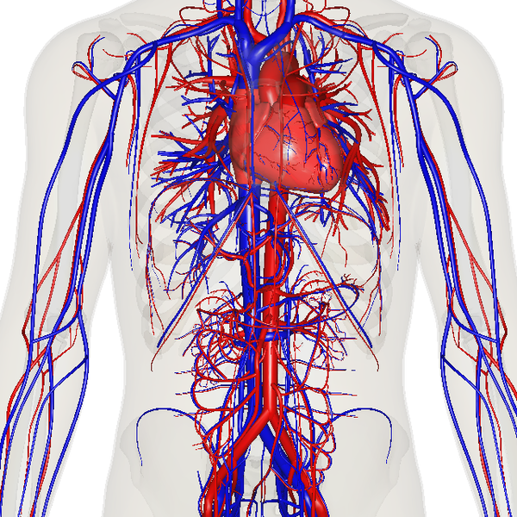
The Circulatory System
The circulatory system is a group of organs which work together to transport gases, nutrients, waste products and heat around the body.
This process is known as circulation.

Slide 17
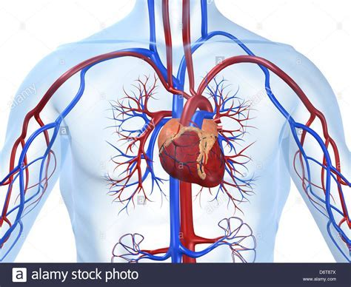
The Circulatory System - Organs
There are three organs in the circulatory system:
Heart – a pair of pumps made of cardiac muscle
Blood vessels – tubes which allow the movement of blood throughout the body
Blood – a liquid organ that carries oxygen, nutrients and water to cells, and removes carbon dioxide and waste from cells

Slide 18
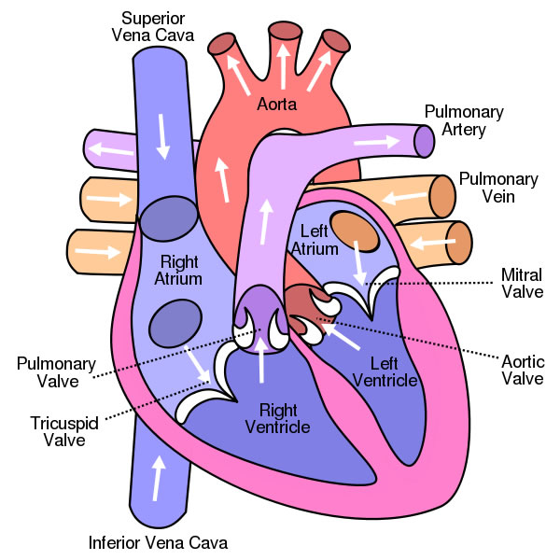
Parts of the Heart
The heart has four chambers:
Two atria (singular: atrium)
The top two chambers, where blood enters
Two ventricles
The bottom two chambers, which blood is pumped out of
The heart also has four main blood vessels:
Pulmonary Artery – sends blood to the lungs
Pulmonary Vein – receives blood from the lungs
Aorta – sends blood to the body
Vena Cava (superior and inferior) – receives blood from the body

Slide 19
The Heart – Left Side
Oxygenated blood from the lungs enters the heart through the pulmonary vein.
It enters the left atrium, and is pumped into the left ventricle.
The oxygenated blood is then pumped out to the body through the aorta.
Valves (mitral and aortic), prevent blood flowing back the wrong way.

Slide 20
The Heart – Right Side
Deoxygenated blood from the body enters the heart through the vena cava.
It enters the right atrium, and is pumped into the right ventricle.
The deoxygenated blood then is pumped out to the lungs through the pulmonary artery.
Valves (tricuspid and pulmonary) prevent blood flowing back the wrong way.

Slide 21
Blood Vessels

Slide 22
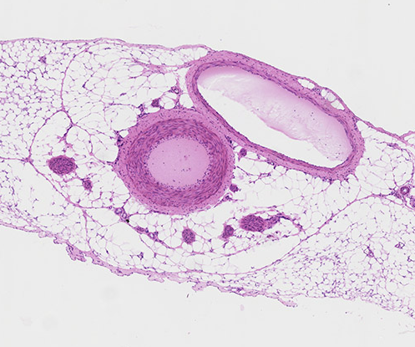
Arteries
Transports blood away from heart.
They have thick, muscular walls to provide strength for high pressure pumping of blood.
They are elastic to maintain blood pressure even when the heart relaxes.
The arteries dilate and constrict, which creates a pulse.
Artery

Slide 23
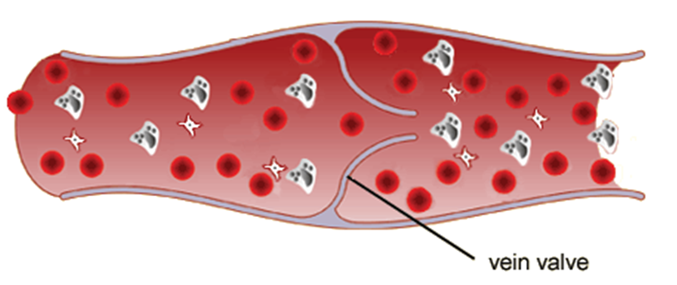
Veins
Vein
Return blood back to heart
They have thinner, more flexible walls
The blood travels at low speed and pressure, due to the distance from the heart.
Veins have one-way valves which allow blood to flow only toward heart.
Movement of your muscles squeeze the veins, putting enough pressure to move blood along.

Slide 24
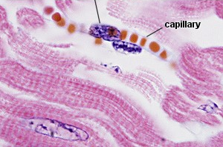
Capillaries
Are the smallest and most numerous of the blood vessels.
They are only one cell thick allowing exchange of nutrients and oxygen into body cells and transports wastes out of the cells.

Slide 25
Blood Components

Slide 26
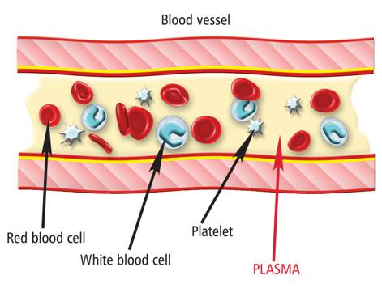
Blood
Is the only organ that exists as a liquid.
The human body has about 5.5 litres of blood.
It is made up of:
Plasma
Red blood cells
White blood cells
Platelets
It carries water, oxygen, nutrients and wastes.
Also helps maintain body temperature.

Slide 27
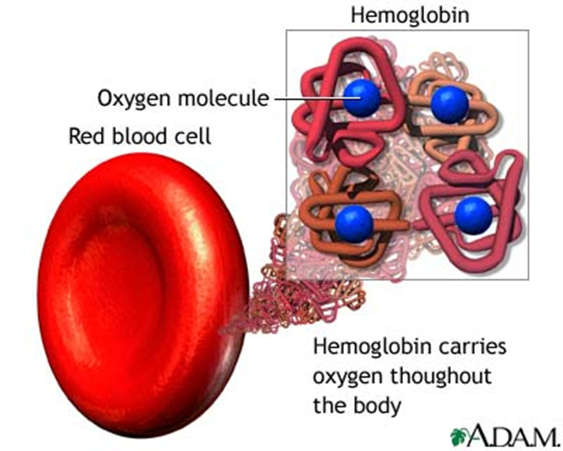
Red Blood Cells
Are made in the bone marrow of long bones (e.g. femur – thigh bone) and ribs
Contains the chemical haemoglobin (gives blood the red colour; it contains iron)
Haemoglobin carries oxygen around the body.
They are disc-shaped and do not have a nucleus.
Also called erythrocytes.

Slide 28
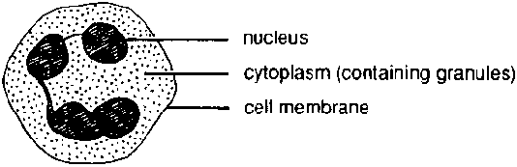
White Blood Cells
Bigger than red blood cells, but less common.
They have no definite shape, but have a nucleus.
Help to fight diseases and infections.
They protect the body from disease by ‘eating’ foreign material and bacteria in the blood.
Also called leukocytes.

Slide 29
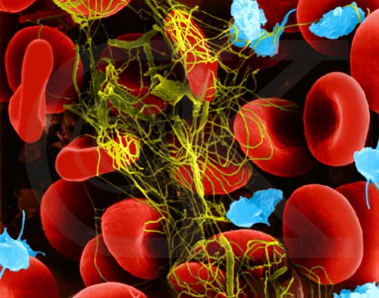
Platelets
Are tiny cells with no nucleus.
Platelets are made of broken bits of cells produced by the bone marrow.
Form sticky clots that plug up damaged blood vessels and stop bleeding.
Too many – causes clots to form in blood vessels (heart – angina; brain – stroke)
Too few – blood does not clot, causing excessive bleeding
Also called thrombocytes.

Slide 30
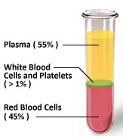
Plasma
Is a clear, yellowish liquid that is mostly water.
Contains dissolved materials such as nutrients, hormones and wastes.
Red blood cells, white blood cells, and platelets are suspended in the plasma.
Helps regulate body temperature by transferring heat around the body.

Slide 31
Circulation

Slide 32
The Heart Contracts and Relaxes
The heart beat begins when the heart muscles relax and blood flows into the atria.
The atria then contract and the valves open to allow blood into the ventricles.
blood from the body
blood from the lungs

Slide 33
The Heart Contracts and Relaxes
The valves close to stop blood flowing backwards.
The ventricles contract forcing the blood to leave the heart.
At the same time, the atria are relaxing and filling with blood again.
The cycle then repeats continuously.

Slide 34
Double Pump System
The circulatory system is a double pump system.
It is called this because there are two separate circuits through which the blood flows.
The right side deals with deoxygenated blood.
The left side deals with oxygenated blood.
Lungs
Body cells

Slide 35
Circulation in the Body
Circuit 1
Circuit 2
In one circuit, the blood flows from the heart to the body and back to the heart.
This circuit carries nutrients and oxygen to the cells.
At the cells, it collects wastes, including carbon dioxide.
The other circuit goes from the heart to the lungs.
In the lungs, carbon dioxide passes out of the blood and oxygen passes into the blood.
The blood rich in oxygen then returns to the heart to be pumped around the body.

Slide 36
Factors Affecting Circulation and Heart Rate

Slide 37
Blood and Circulation
All the cells in your body need oxygen and nutrients in order to function.
Blood carries the oxygen and nutrients to individual cells through the blood vessels.
As the cells use oxygen and nutrients for energy, they are producing waste products.
These waste products are carried away from the cells in the blood.

Slide 38
Circulation and Exercise
When you begin to exercise, your cells use more energy and oxygen, and produce more waste products.
This means your blood needs to move faster through your body to keep a constant supply of nutrients, and remove the wastes.
To make the blood circulate faster, your heart needs to beat more frequently.
You can detect this change in heart rate through your pulse.

Slide 39
Excretory System

Slide 40
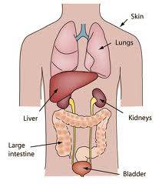
The Excretory System
Our bodies produce a number of substances that need to be removed to avoid damage to our bodies.
Organs in the excretory system are responsible for removing wastes from the body.
These organs include the kidneys, liver, lungs and skin.

Slide 41
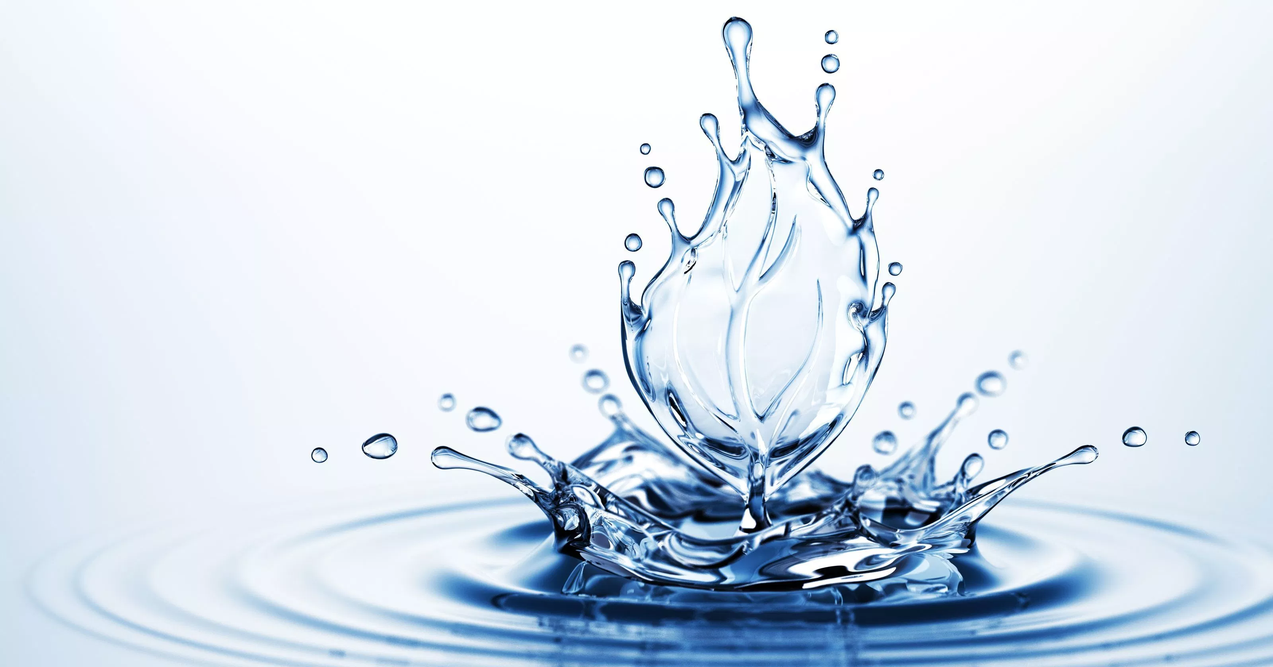
Role of Water
Water is important in controlling wastes.
It can dilute harmful substances, which reduces their impact on the body.
It also helps move substances quickly through the body.
It is essential in regulating body temperature.

Slide 42
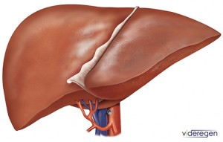
The Liver
The liver is responsible for breaking down many substances, especially wastes.
It changes harmful substances into less dangerous forms before their removal from the body.

Slide 43
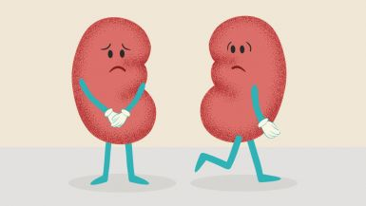
The Kidneys & Bladder
You have two kidneys in your body.
Blood carrying waste products passes through the kidneys.
The kidneys filter waste from the blood.
At the end of the filtering process, there are two main products – clean blood and urine.
The bladder stores urine until it is released from the body.

Slide 44
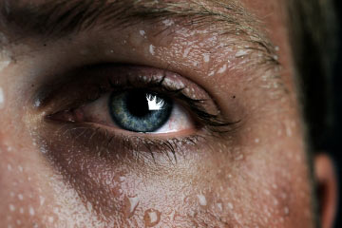
The Skin
The skin releases waste heat by evaporation from wet skin (sweat).
Sweat also contains waste products such as urea and salt.

Slide 45
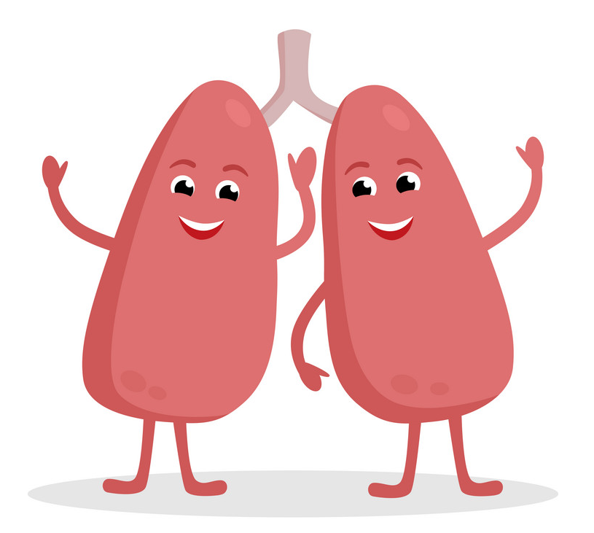
The Lungs
Carbon dioxide is produced as a waste product in cells.
Blood carries the carbon dioxide to the lungs.
The carbon dioxide moves into the air inside the lungs and is breathed out.

Slide 46
Excretory Organs Work Together
When proteins are digested, they are broken down into amino acids.
Your body cannot store excess amino acids, so the liver breaks them down further for energy.
This produces a harmful substance called ammonia, which the liver turns into a chemical called urea.
The urea is transported to the kidneys in the blood.
The kidneys filter out the urea, which leaves the body in urine.

